Slide 1
Python – Keywords & Identifiers
Premanand S

Slide 2
Keywords
Reserved words
Fundamental building blocks for program
Specific meanings and restrictions around how they should be used
Cannot be used as variable name and function name
Case sensitive
3.9.7 – 36 keywords (may differ for each versions)
IDEs - Highlight keywords to differentiate them from other words in your code
True, False, None – remaining all in lower case

Slide 3
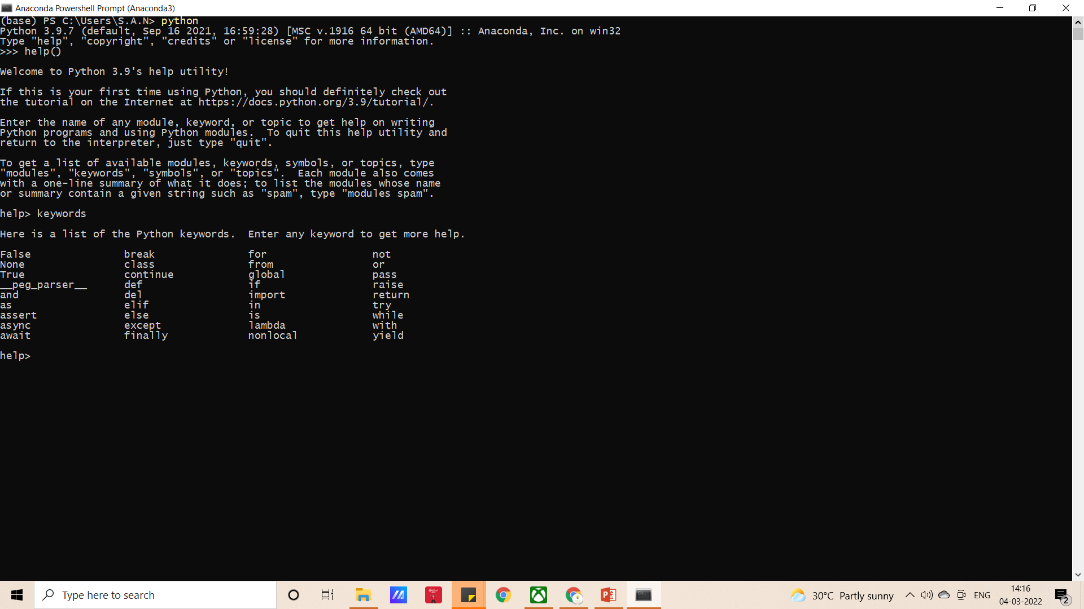
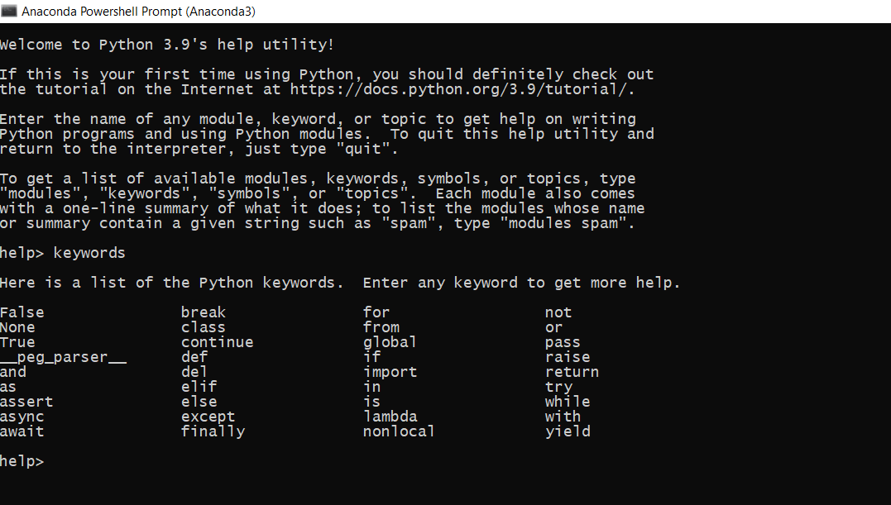
How to check -keywords

Slide 4
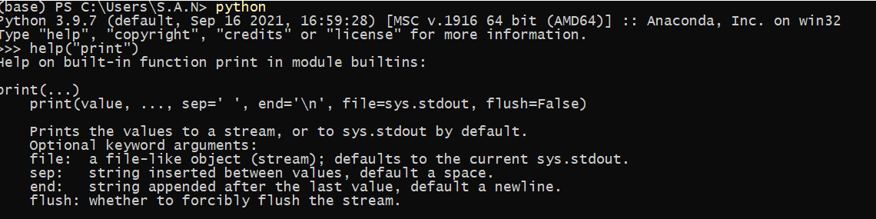
Keywords – help()

Slide 5
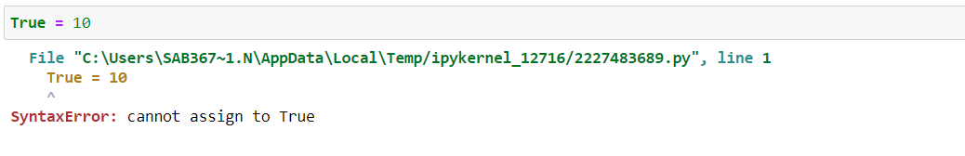
SyntaxError

Slide 6
Importance of keywords
Value Keywords: True, False, None
Operator Keywords: and, or, not, in, is
Control Flow Keywords: if, elif, else
Iteration Keywords: for, while, break, continue, else
Structure Keywords: def, class, with, as, pass, lambda
Returning Keywords: return, yield
Import Keywords: import, from, as
Exception-Handling Keywords: try, except, raise, finally, else, assert
Asynchronous Programming Keywords: async, await
Variable Handling Keywords: del, global, nonlocal

Slide 7
Keywords - Importance
Understanding their proper use is key to improving your skills and knowledge of Python.

Slide 8
IDENTIFIERS

Slide 9
Identifiers
Name given to entities like class, functions, variables, etc
Helps us to differentiate from other names

Slide 10
Norms
Combination of a-z, A-Z, 0-9 and _
Cannot start with numbers
Keywords cannot be used
Special characters like !, @, #, $, % not allowed
Can be of any length
Case sensitive, Eg: Name name are not same
Name should be anything but with sense is good programming habbit. Eg: a=‘prem’ can be name =‘prem’
Underscore can be used for multiple words. Eg: what_is_your_name

